Slide 1
The FLR platform
Summer School 2019 – Capo Granitola 15-19 July

Slide 2
What is FLR
The Fisheries Library in R (FLR) is a collection of tools for quantitative fisheries science, developed in the R language, that facilitates the application of a wide range of quantitative analysis as well as the construction of bio-economic simulation models of fisheries systems.
OPEN SOURCE

Slide 3
What is FLR
Mission statement
The FLR project provides a platform for quantitative fisheries
science based on the R statistical language. The guiding principles
of FLR are:
• openness - through community involvement and the open
source ethos
• flexibility - through a design that does not constrain the user
to a given paradigm
• extendibility - through the provision of tools that are ready
to be personalized and adapted.

Slide 4
What is FLR
With many applications including:
Stock assessment (VPA, XSA, a4a, SAM)
Fit stock-recruitment relationships (FLBRP)
Model fleet dynamics (including economics)
Simulate and evaluate management procedures and HCRs (MSE)
A team of devoted developers
A community of active users
A collection of R packages
Notes:
<number>

Slide 5
What is FLR: Packages
FLCore
Stock Assessment
Advice & Forecast
Plotting
FLash
ggplotFL
FLAsses
FLAsses
FLAsses
FLXSA
FLa4a
FBRP

Slide 6
What is FLR: FLCore
The FLCore package defines a series of data structures that represent different elements of the fishery system.
These structures are defined using R’s Object Oriented S4 class system, while functions to operate on those classes are defined as methods.
In this way function call (e.g. plot()) can be used on different classes and their behavior is consistent with the class structure and content.
Class: e.g data.frame, vector , matrix
Method: e.g. summary, plot
For further information on the S4 class system, please look at: https://stat.ethz.ch/R-manual/R-patched/library/methods/html/Introduction.html

Slide 7
What is FLR: Basic and Composite and Plural Classes
FLArray, FLQuant & FLCohort
FLPar
FLQuantPoint
FLQuantDistr
FLQuantJK
Basic
FLStock
FLSR
FLIndex
FLBiol
Composite
FLStocks
FLQuants
FLIndices
FLBiols
Plural

Slide 8
What is FLR: FLQuant
The FLQuant class is the basic data structure for FLR, and it is in essence a 6D array on which data and outputs can be stored, structured along dimensions related to time, space, age or length, etc. FLQuant first dimension is free to have any name, quant by default, commonly age, while the other five have set names:
year: year of the data point.
unit: any subdivision of the data not based on space or time, for example gender
(male and female).
season: any time step shorter than year (e.g. month, quarter, week).
area: spatial subdivision of data
iter: multiple iterations of the same process (e.g. bootstrap, Bayesian, Monte Carlo, …)
An object of class "FLQuant"
An object of class "FLQuant"
, , unit = unique, season = all, area = unique
year
age 2012 2013 2014 2015 2016 2017
1 0.60352 0.97440 0.99065 1.68515 1.36443 5.05653
2 1.93833 2.09946 3.13919 0.84972 0.53418 0.69980
3 0.24826 1.51710 5.28007 0.61229 0.59522 1.19544
4 3.14748 6.16351 1.06234 0.93561 1.43151 0.81529
units: t

Slide 9
What is FLR: FLQuant
Class structure
array
• 6 dims: (quant), year, unit, season,
area, iter)
quant dim could be age or length
attributes
• units: character
> array(1:144, dim=c(6,6,2,2,2))
, , 1, 1, 1
[,1] [,2] [,3] [,4] [,5] [,6]
[1,] 1 7 13 19 25 31
[2,] 2 8 14 20 26 32
[3,] 3 9 15 21 27 33
[4,] 4 10 16 22 28 34
[5,] 5 11 17 23 29 35
[6,] 6 12 18 24 30 36
, , 2, 1, 1
[,1] [,2] [,3] [,4] [,5] [,6]
[1,] 37 43 49 55 61 67
[2,] 38 44 50 56 62 68
[3,] 39 45 51 57 63 69
[4,] 40 46 52 58 64 70
[5,] 41 47 53 59 65 71
[6,] 42 48 54 60 66 72
, , 1, 2, 1
[,1] [,2] [,3] [,4] [,5] [,6]
[1,] 73 79 85 91 97 103
[2,] 74 80 86 92 98 104
[3,] 75 81 87 93 99 105
[4,] 76 82 88 94 100 106
[5,] 77 83 89 95 101 107
[6,] 78 84 90 96 102 108
dfa= cbind(expand.grid(d1=1:3, d2=1:3, d3=1:2, d4=1:2, d5=1:2, d6=1:2),data=1:144)
> head(dfa,36)
d1 d2 d3 d4 d5 d6 data
1 1 1 1 1 1 1 1
2 2 1 1 1 1 1 2
3 3 1 1 1 1 1 3
4 1 2 1 1 1 1 4
5 2 2 1 1 1 1 5
6 3 2 1 1 1 1 6
7 1 3 1 1 1 1 7
8 2 3 1 1 1 1 8
9 3 3 1 1 1 1 9
10 1 1 2 1 1 1 10
11 2 1 2 1 1 1 11
12 3 1 2 1 1 1 12
13 1 2 2 1 1 1 13
14 2 2 2 1 1 1 14
15 3 2 2 1 1 1 15
16 1 3 2 1 1 1 16
17 2 3 2 1 1 1 17
18 3 3 2 1 1 1 18
19 1 1 1 2 1 1 19
20 2 1 1 2 1 1 20
21 3 1 1 2 1 1 21
22 1 2 1 2 1 1 22
23 2 2 1 2 1 1 23
24 3 2 1 2 1 1 24
25 1 3 1 2 1 1 25
26 2 3 1 2 1 1 26
27 3 3 1 2 1 1 27
28 1 1 2 2 1 1 28
29 2 1 2 2 1 1 29
30 3 1 2 2 1 1 30
31 1 2 2 2 1 1 31
32 2 2 2 2 1 1 32
33 3 2 2 2 1 1 33
34 1 3 2 2 1 1 34
35 2 3 2 2 1 1 35
36 3 3 2 2 1 1 36

Slide 10
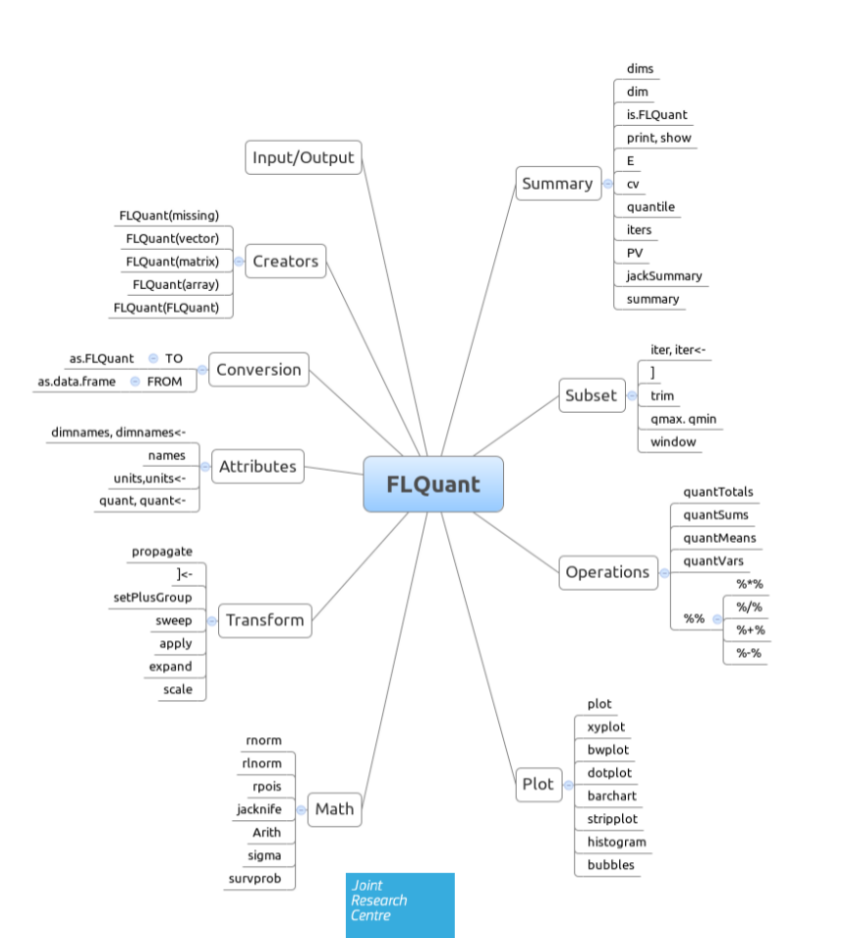
What is FLR: FLQuant Methods

Slide 11
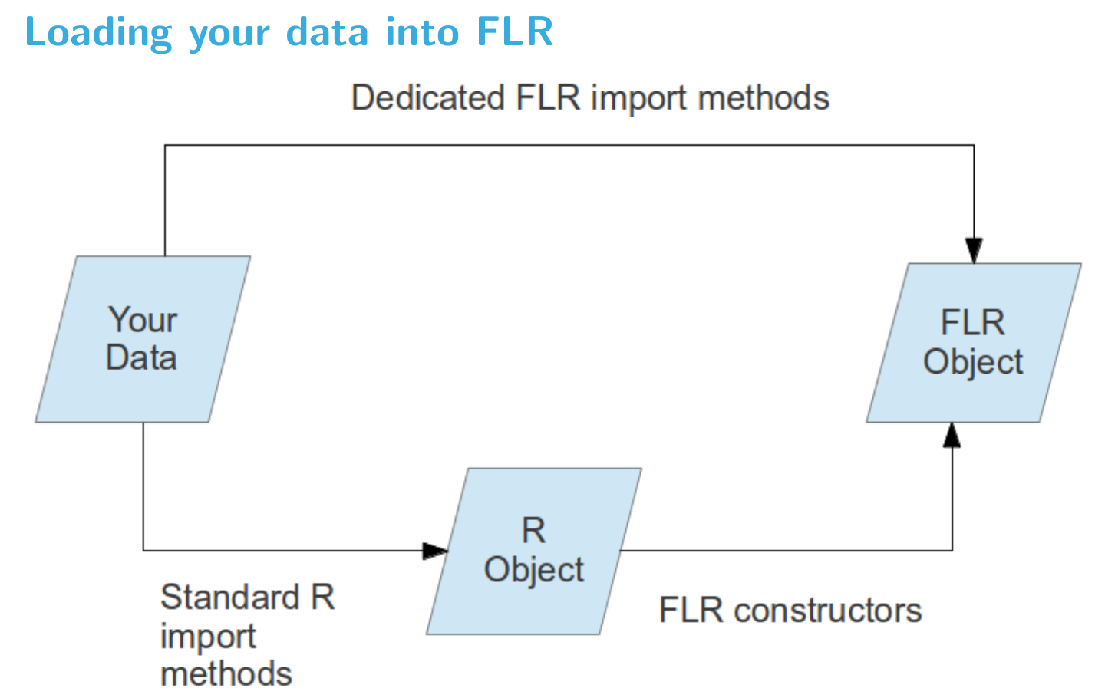
What is FLR: Loading data

Slide 12
What is FLR: Loading data
Dedicated FLR import functions
Data needs to be in specific format
readVPAFile()
readFLStock()
readFLIndex()
readFLIndices()

Slide 13
What is FLR: Loading data
Standard R import functions
http://cran.r-project.org/doc/manuals/R-data.html
Enter by hand into R
CSV files: read.table(), read.csv(), fread with data,table, etc
Text files: scan()
Database: RODBC package
Direct link to spreadsheets: excel.link, RexcelInstaller packages

Slide 14
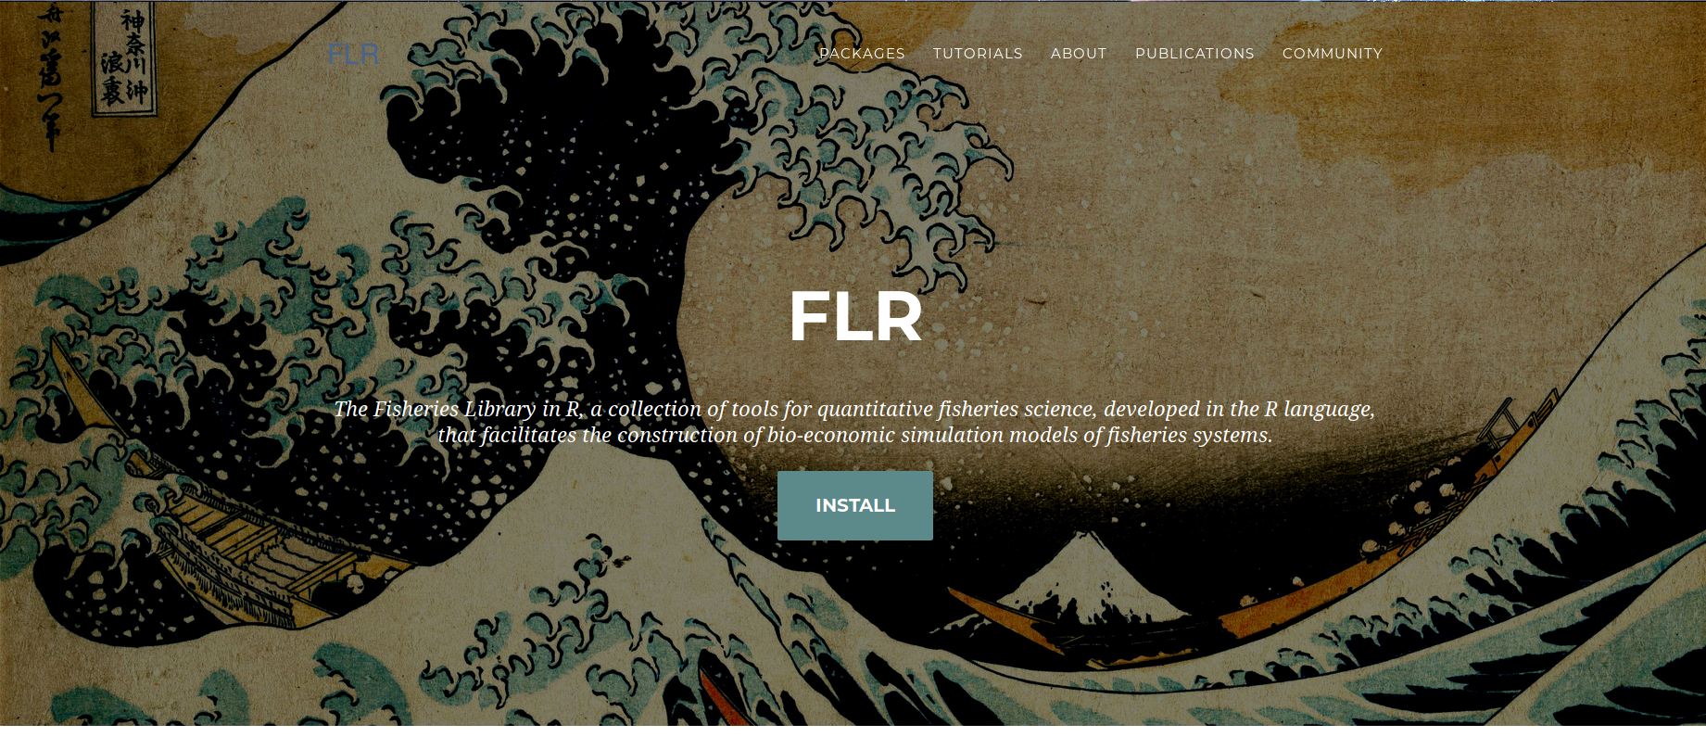
What is FLR: Go for FLCore & friends
Installing FLR
To install the latest released versions of the FLR packages, and all their dependencies, start R and enter
source("http://flr-project.org/R/instFLR.R")
or select your choice of packages from the FLR repository by calling
install.packages(repos="http://flr-project.org/R")
A good starting point to explore FLR is A quick introduction to FLR
FLR Project @ http://flr-project.org
Source code @ http://github.com/flr/

